Slide 1
Cancel a Budget Forecast Report (BFR)
Please Note: Users can only cancel BFRs that are in BFR Incomplete status. Please contact the Ministry if the BFR has been submitted to report a material change in information.

Slide 2
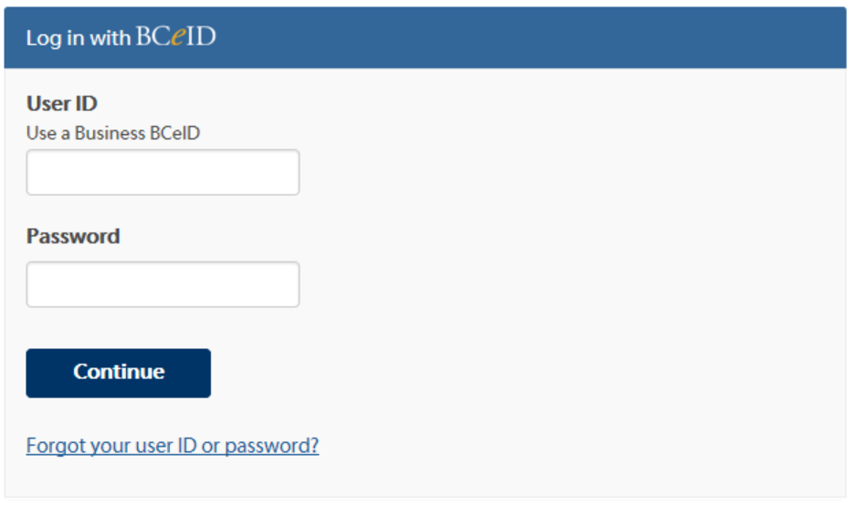
Log in to the Local Government Information System (LGIS) using your Business BCeID.
www.localgovernmentinformationsystem.gov.bc.ca
username
password

Slide 3
Using the left hand navigation, select Capital Grants then Manage Projects.
Open your project by selecting the project hyperlink.

Slide 4
Click on the BFR number hyperlink of the BFR you want to cancel.
Reminder: Users can only cancel BFRs that are in BFR Incomplete status. Please contact the Ministry to report a material change in information if the BFR has been submitted .

Slide 5
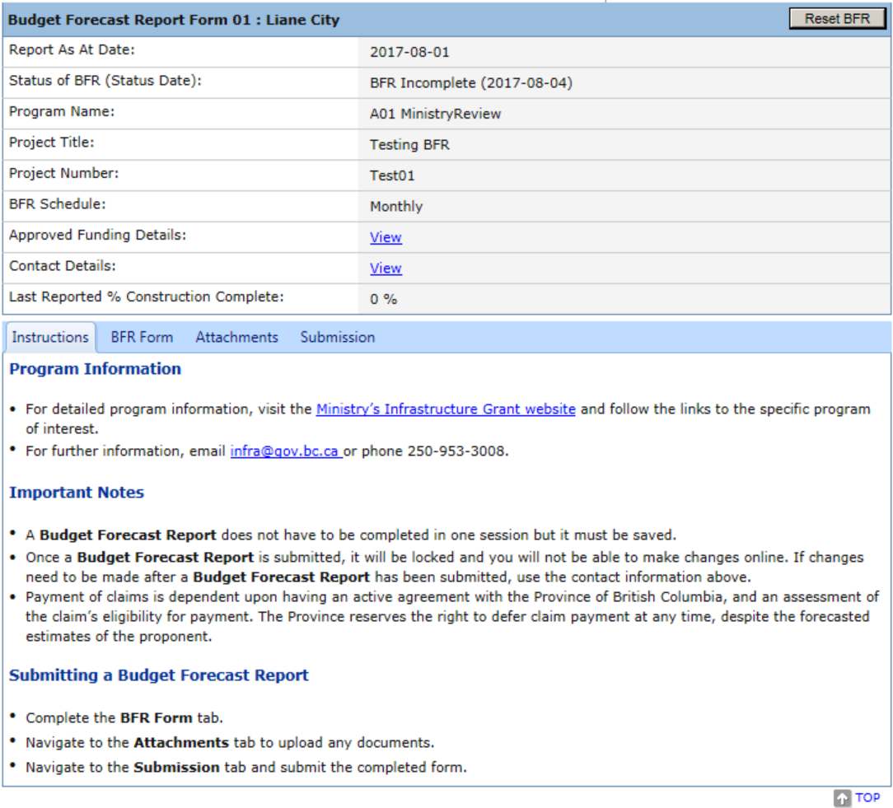
Navigate to the Submission tab.

Slide 6
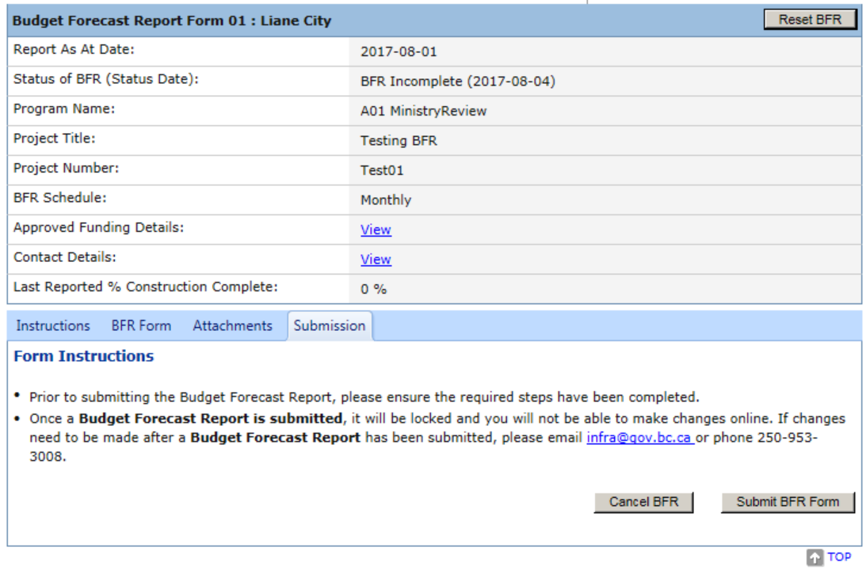
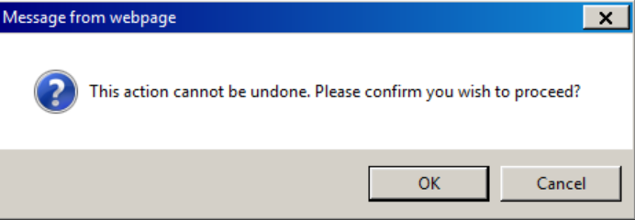
Click on ‘Cancel BFR’.
A message will appear to confirm the cancellation of the BFR.
Click OK to cancel.

Slide 7
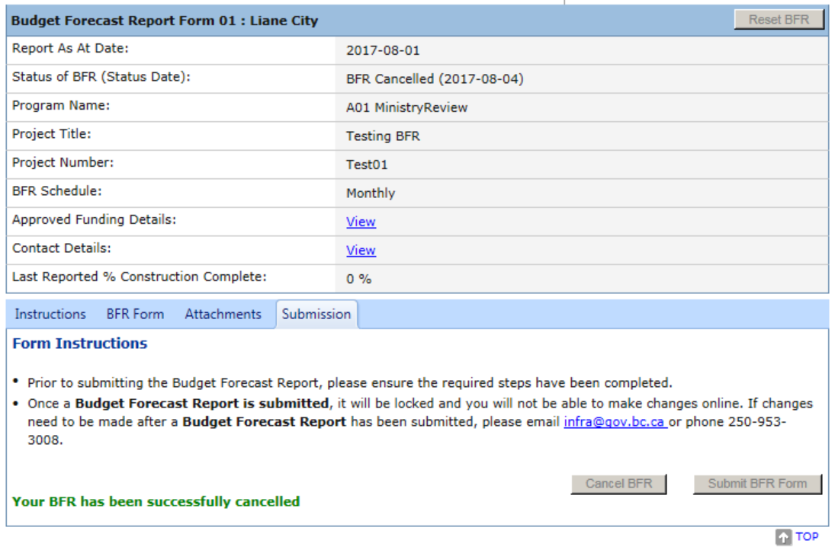
Confirmation that the BFR has been cancelled will display
.

Slide 8
LGIS Website : https:/www.localgovernment informationsystem.gov.bc.ca/LGIS For assistance please contact: Phone: (250) 953-3008 Email : infra@gov.bc.ca

